Slide 1

Statistics Can Be Misleading…..

Slide 2
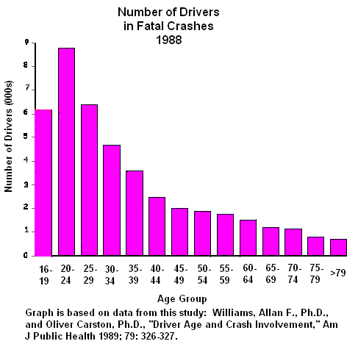
1. The following statistics suggest that 16-year-olds are safer drivers than people in their twenties, and that octogenarians are very safe. Is this true?

Slide 3
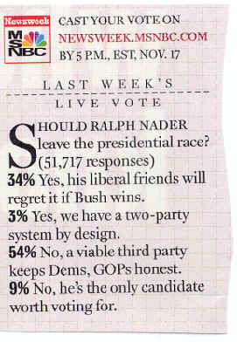
2. On November 13, 2000, Newsweek published the following poll results:
Since 9% said that Nader was the only candidate worth voting for, one would have expected him to get at least 9% of the vote in the 2000 election. He only got about 3%. What happened?

Slide 4
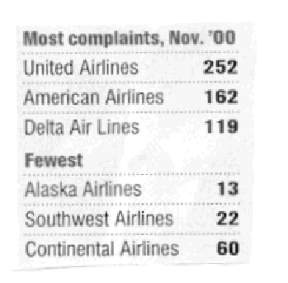
3. Consider these complaints about airlines published in US News and World Report on February 5, 2001:
Can we conclude that United, American, and Delta are the worst airlines and Alaska, Southwest, and Continental are the best?

Slide 5
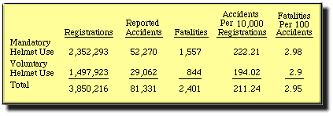
4. The following statistics about motorcycle helmet use seem to suggest that helmets cause more injuries and fatalities. Is it really safer to go without helmets?

Slide 6
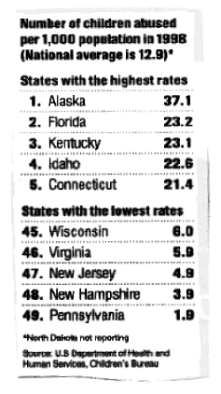
5. This clipping from US News and World Report on 1/29/01 suggests that Alaskans are terrible parents. Is this true?

Slide 7
6. Researchers found that gun owners are 2.7 times more likely to be murdered than non-owners. Does this mean it's safer to not have guns in the house?

Slide 8

7. "The best public schools offer a more challenging curriculum than most private schools." Are public schools therefore better than private schools?

Slide 9
9. "Fluoride consumption by human beings increases the general cancer death rate. …. [P]eople in fluoridated areas have a higher cancer death rate than those in non-fluoridated areas." Should fluoridation be prohibited?

Slide 10
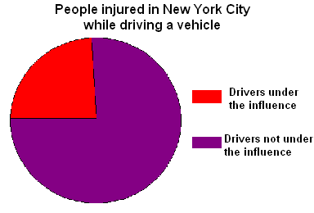
9. Can we conclude from the following diagram that it's safer to drive while under the influence?

